Slide 1

Polymer or not Polymer that is the question
DataArt Summer School 2015
Alexander Kasheverov

Slide 2

Who am I

Slide 3
Plan
Intro
Web Components
Polymer
Live Example
Conclusion
Homework

Slide 4
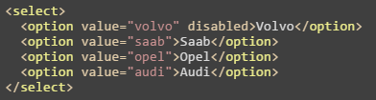
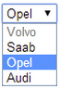
It all starts with elements

Slide 5
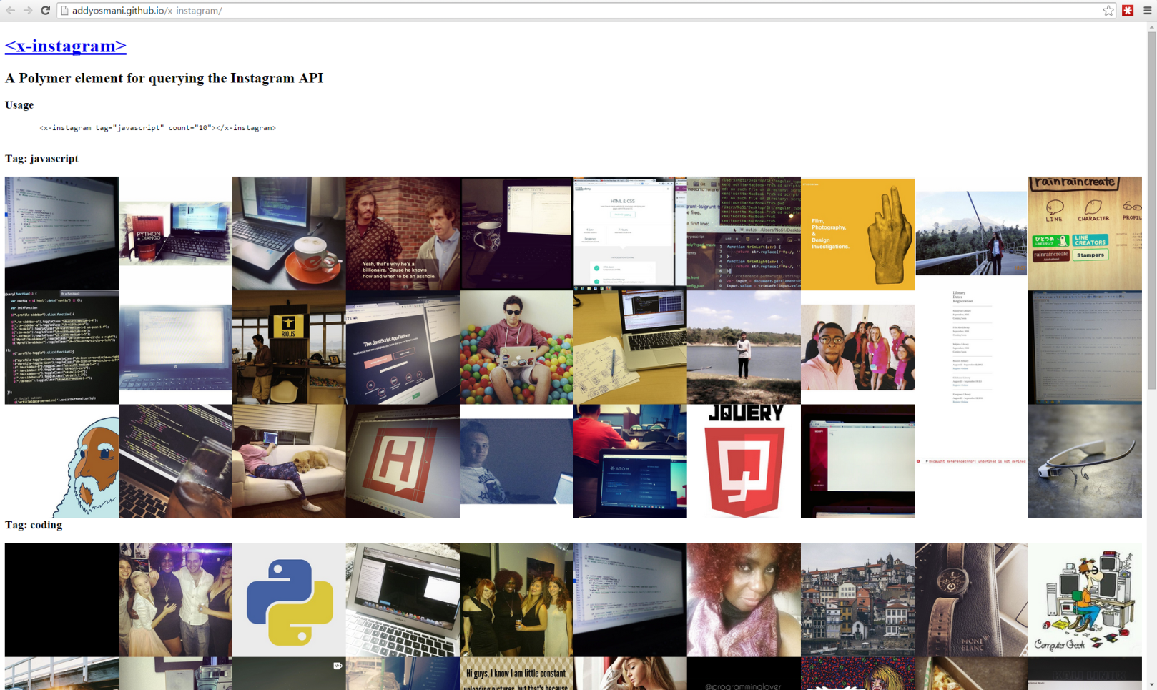
It all starts with elements
<x-instagram tag="javascript" count="10"></x-instagram>
addyosmani.github.io/x-instagram/

Slide 6
It all starts with elements

Slide 7
Web components
First draft in 2012
Custom elements
Templates
Shadow DOM
Html imports
It brings native component-based solutions in browsers

Slide 8
Web components -> Custom elements
var XFoo = document.registerElement('x-foo', {
prototype: Object.create(HTMLElement.prototype, {
bar: { get: function() { return 5; } },
foo: { value: function() { alert('foo() called'); } }
})
});
<x-foo></x-foo>
var xfoo = document.createElement('x-foo');
document.body.appendChild(xfoo);

Slide 9
Web components -> Custom elements
var MegaButton = document.registerElement(‘mega-button', {
prototype: Object.create(HTMLButtonElement.prototype),
extends: 'button'
});
<button is="mega-button">
var btn = document.createElement( 'button', 'mega-button‘ );

Slide 10
Web components -> Templates
<template id="mytemplate">
<img src="" alt="great image">
<div class="comment"></div>
</template>
// Populate the src at runtime.
var t = document.querySelector('#mytemplate');
t.content.querySelector('img').src = 'logo.png';
var clone = document.importNode(t.content, true);
document.body.appendChild(clone);
Template is totally hidden until is used
There's no way to "prerender" a template, meaning you cannot preload assets, process JS, download initial CSS, etc
Nested templates require that their children also be manually activated

Slide 11
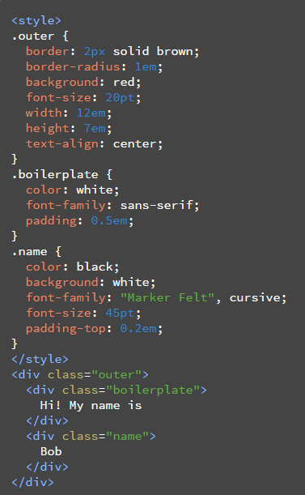
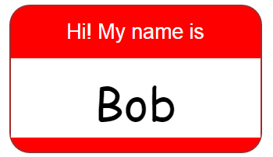
Web components -> Shadow DOM
Hide Presentation Details

Slide 12
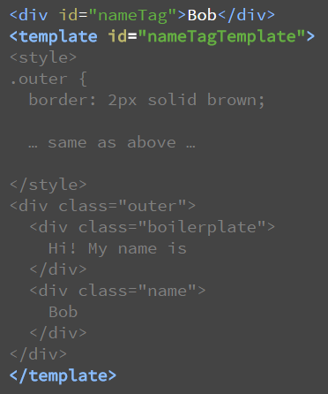
Web components -> Shadow DOM
<script>
var shadow = document.querySelector('#nameTag').createShadowRoot();
var template = document.querySelector('#nameTagTemplate');
var clone = document.importNode(template.content, true);
shadow.appendChild(clone);
</script>

Slide 13
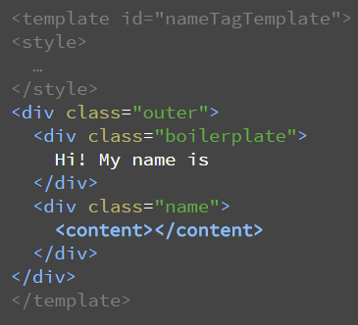
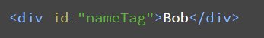
Web components -> Shadow DOM
Separate Content from Presentation

Slide 14
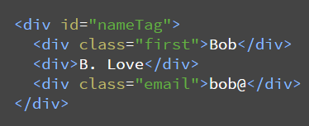
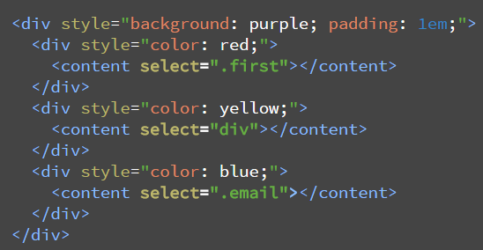
Web components -> Shadow DOM
document
Shadow root

Slide 15
Web components -> Html imports
How to load different types of resources?
<script src>
<link rel="stylesheet">
<img>
<video>
<audio>
<iframe>
AJAX
???

Slide 16
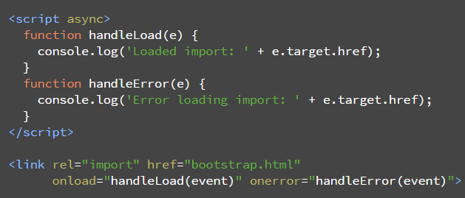
Web components -> Html imports
A new one:
<link rel="import" href="/path/to/imports/stuff.html">
Instead of loading html/css/js for Bootstrap separately you could import just an html file

Slide 17
Web components support by browser
Works in ever-green browsers (auto-update)
And what about others?

Slide 18
Polymer
It’s not a framework
Adds shims for browsers that don’t support web components
Adds sugar
A slogan `we have an element for that`
Updated this year to version 1.0
Less code 35% overall
Speed increased 3x (chrome), 4x (mobile safari)

Slide 19
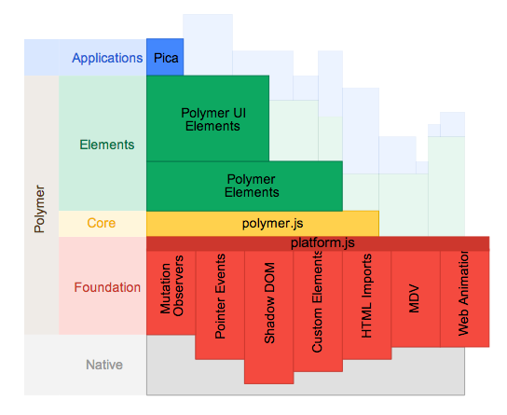
Polymer

Slide 20
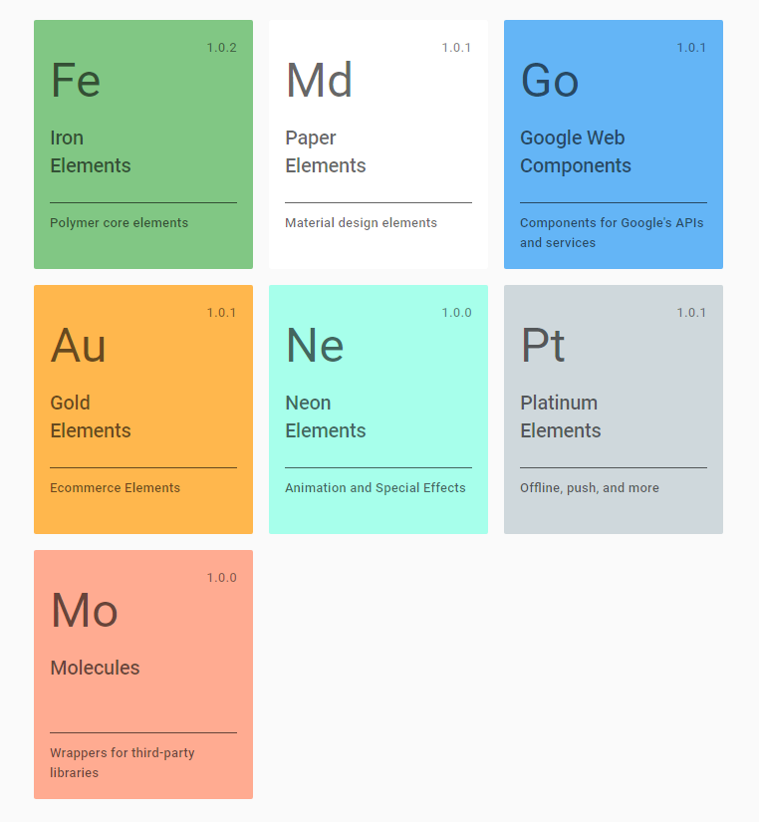
Elements

Slide 21
Elements -> iron elements
<iron-ajax
auto url="http://gdata.youtube.com/feeds/api/videos/"
params='{"alt":"json", "q":"chrome"}'
handle-as="json"
on-response="handleResponse"
debounce-duration="300">
</iron-ajax>
<iron-icon src="star.png"></iron-icon>
<iron-media-query query="(min-width: 600px)" query-matches="{{queryMatches}}">
</iron-media-query>

Slide 22
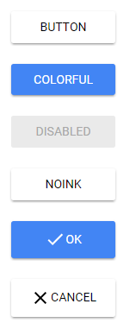
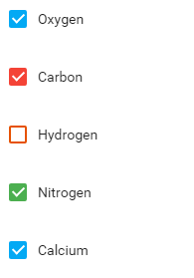
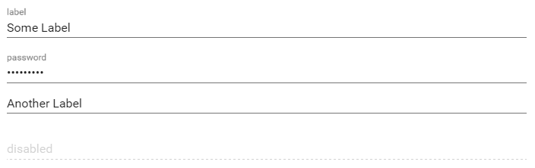
Elements -> paper elements
<paper-button>flat button</paper-button>
<paper-button raised>raised button</paper-button>
<paper-button noink>No ripple effect</paper-button>
<paper-input error-message="Invalid input!" label="Input label">
</paper-input>
<paper-checkbox checked> label</paper-checkbox>

Slide 23
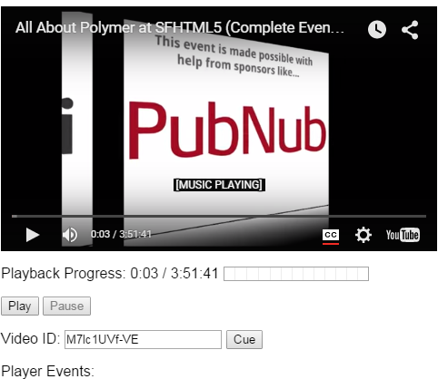
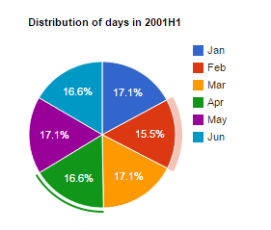
Elements -> google web components
<google-youtube
video-id="..."
height="270px"
width="480px"
rel="0"
start="5"
autoplay="1">
</google-youtube>
<google-chart
type='pie'
options='{"title": "Distribution of days in 2001Q1"}'
cols='[{"label":"Month", "type":"string"}, {"label":"Days", "type":"number"}]'
rows='[["Jan", 31],["Feb", 28],["Mar", 31]]'>
</google-chart>

Slide 24
Alternatives
http://x-tags.org/
http://bosonic.github.io/

Slide 25
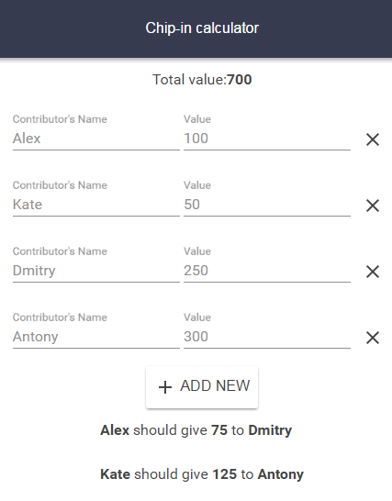
Example

Slide 26
Installation
Install node + npm
npm install –save bower
bower init
bower install --save Polymer/polymer#^1.0.0
Installed in a `bower_components` folder
OR
Manually download/unpack from here polymer-project.org

Slide 27
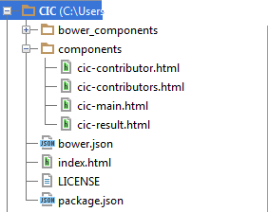
Structure

Slide 28
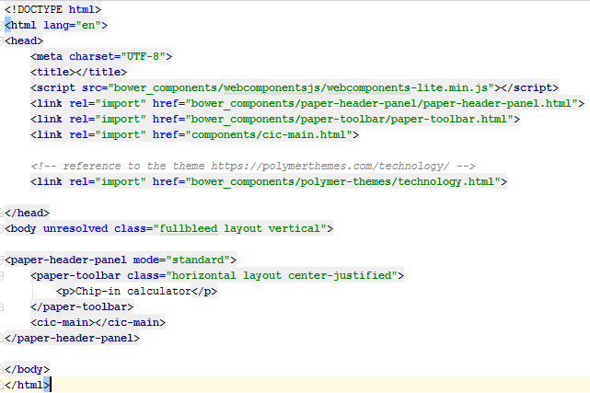
index.html

Slide 29
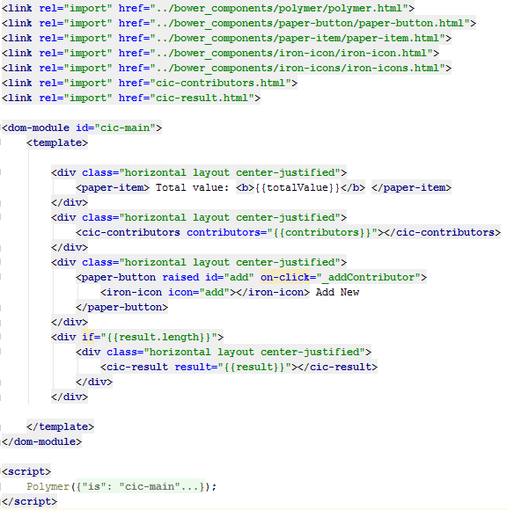
components/cic-main.html

Slide 30
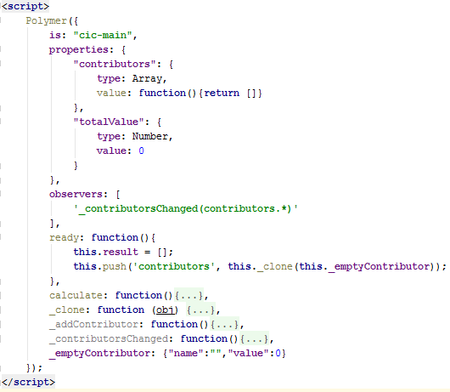
components/cic-main.html

Slide 31
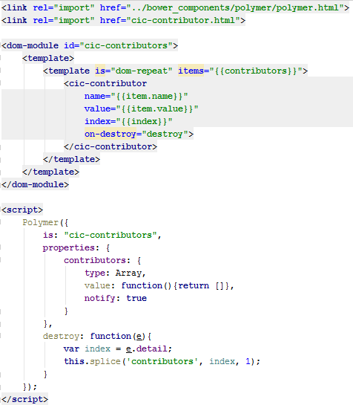
components/cic-contributors.html

Slide 32
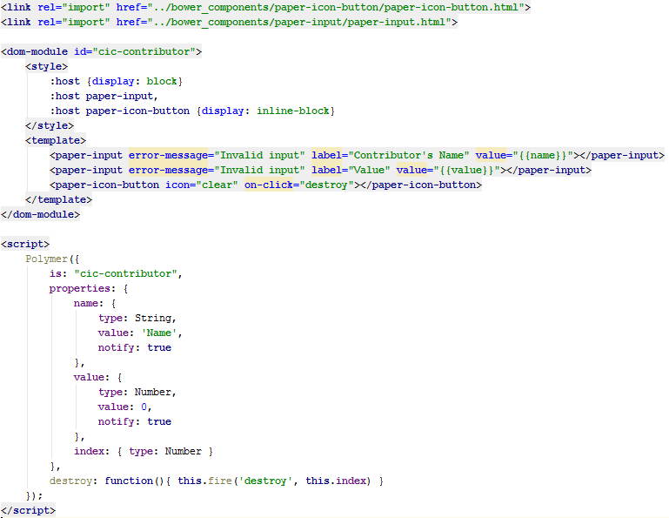
components/cic-contributor.html

Slide 33
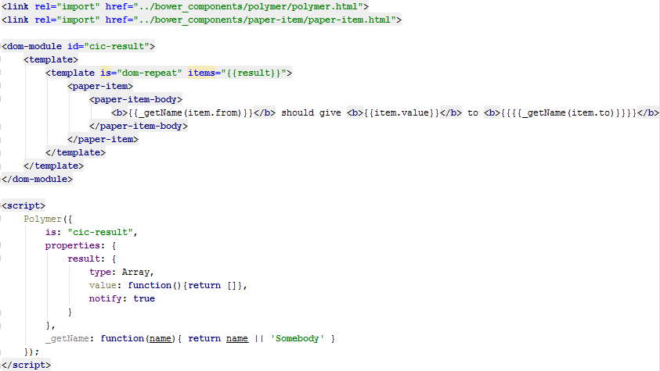
components/cic-result.html

Slide 34
Questions
?

Slide 35
Useful links
Web components & Polymer
webcomponents.org
jonrimmer.github.io/are-we-componentized-yet/
www.html5rocks.com/en/
polymer-project.org
Chip-in calculator
chip-in.me
code: github.com/kashesandr/CIC

Slide 36
Homework

